Slide 1
I400 – Application Development in Java
Lecture 7

Slide 2
Today
CH 9 – Objects & User-defined Classes
Constructors, Getters / Setters
Null
Static vs Instance
Public vs Private
Packages

Slide 3


Scope Reminder
Remember, local variables (those created inside a method) only exist in the local scope. If you try to access them elsewhere, you’ll get an error!

Slide 4
Objects in Java
A class is a template for the creation of objects. An instance is a specific object.
Java uses specific terminology for objects.
The state of an object consists of all of the object’s data fields (called attributes in Python)
The behavior of an object consists of all methods that can be used with that object

Slide 5
Objects in Java
A class has a specific method, called a constructor, that is used in the creation of instances.
Often, the constructor is used to set up initial values for the state of the object.
Methods defined inside of the class become part of the object’s behavior.

Slide 6
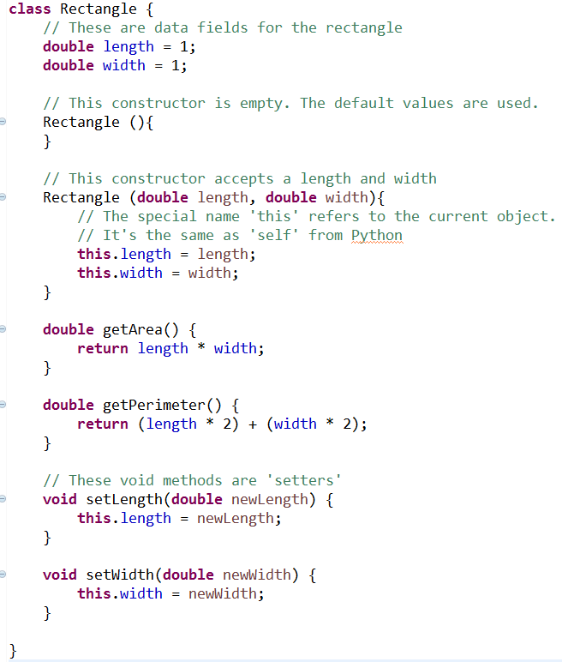
Anatomy of a Class
We use the keyword class to define a new class.

Slide 7
Anatomy of a Class
Any class data fields are defined below the class header.
Each instance gets its own copy of these.

Slide 8
Anatomy of a Class
A class can have any number of constructors.
This class has two:
one for the default values
another for custom values

Slide 9
Anatomy of a Class
The special variable name this refers to the current instance.
It’s the same as self in Python.

Slide 10
Anatomy of a Class
This class has two value-returning getter methods.
These are also called access methods.
Note that using this is optional if no local variable has the same name.

Slide 11
Anatomy of a Class
Finally, we see two void setter methods to change the data field values.
These are also called mutator methods.

Slide 12
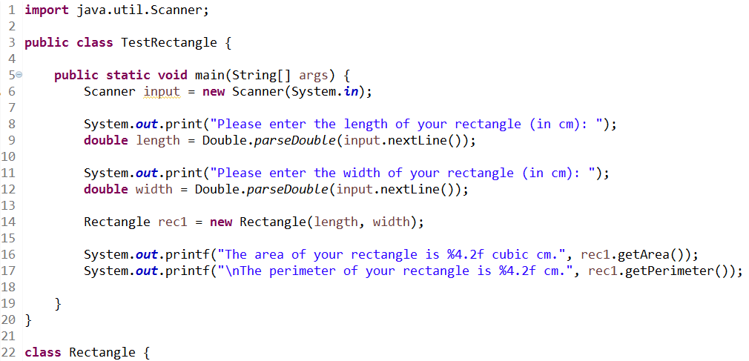
Invoking the Constructor
We instantiate a Rectangle. The new keyword invokes the class constructor.

Slide 13
Calling Methods
We then call two methods from the object. Note that the Rectangle class doesn’t need to appear above the TestRectangle class.

Slide 14

Rectangle Output

Slide 15
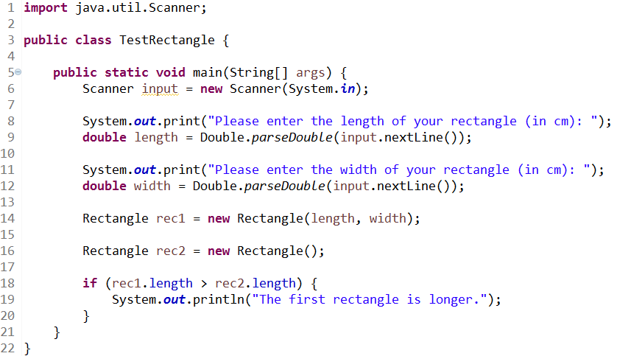
Accessing Data Fields
We can also access the data fields of an object directly – although we may not want to allow this in the future.

Slide 16

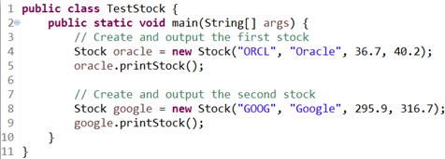
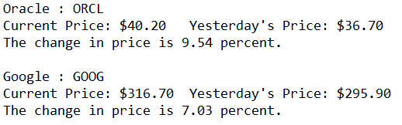
Stocks (Group Work)
Stocks have:
a name (String)
a symbol (String)
a current price (double)
a previous price (double)
Write a Stock class that has suitable data fields, a constructor, and a printStock() method that produces this kind of output:
(You don’t need methods to get or set the data fields)
(Test code can be downloaded from Canvas!!)

Slide 17
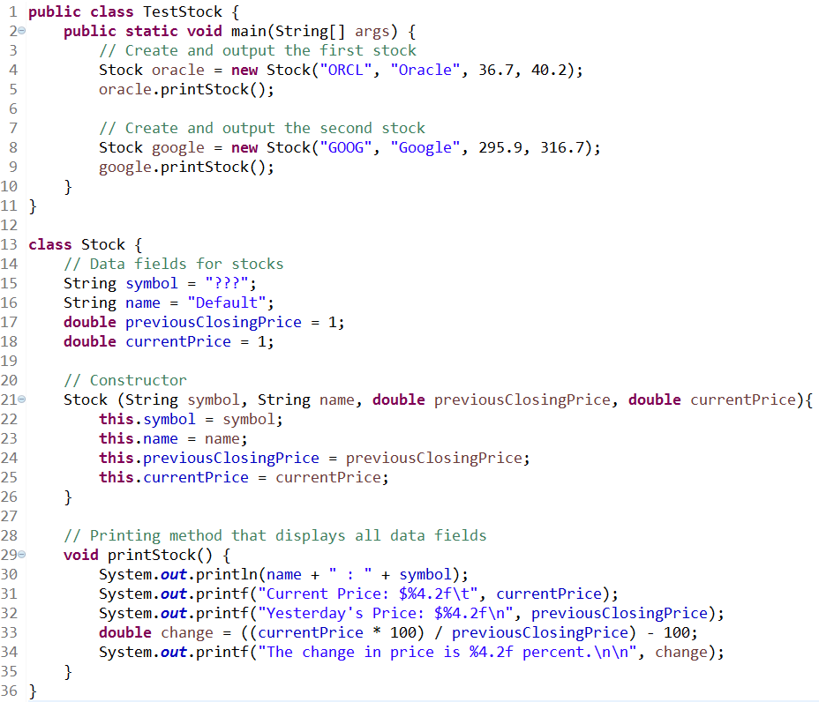
Stocks (Solution)

Slide 18
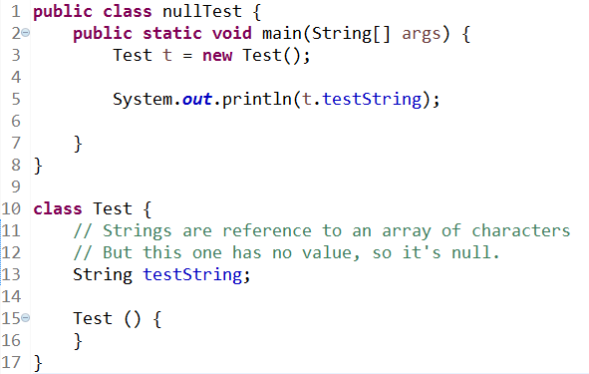

Null
Java has a special value called null that’s similar to None in Python.

Slide 19
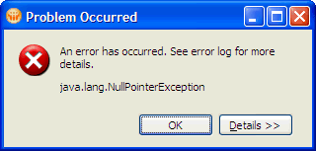
Null Pointers
NullPointerException is a common type of runtime error in Java.
It occurs when you try to invoke a method on an object, or reference its value, but you have not yet given the object a value (so its value is null).

Slide 20
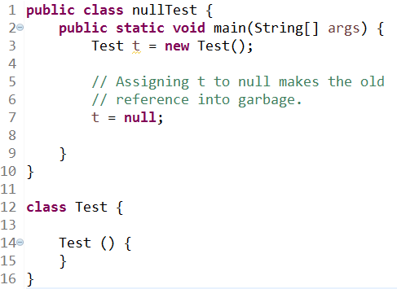
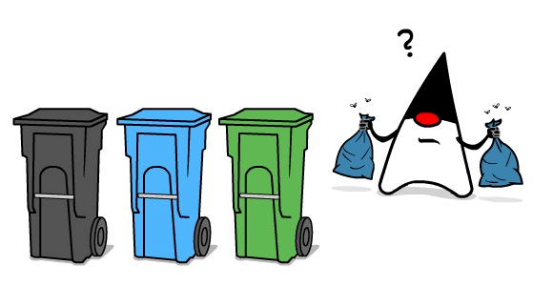
Garbage Collection
In this example, when t is assigned null, the old value of t is no longer reference by anything. This useless object (garbage) takes up memory!
Java is a garbage-collected language: The Java Virtual Machine (JVM) automatically detects and eliminates garbage.

Slide 21
Static vs Instance
Data fields that belong to individual objects are also called instance variables.
In contrast, some data fields are suitable for belonging to the entire class – these are called static variables.
Static variables were called class attributes in Python.

Slide 22
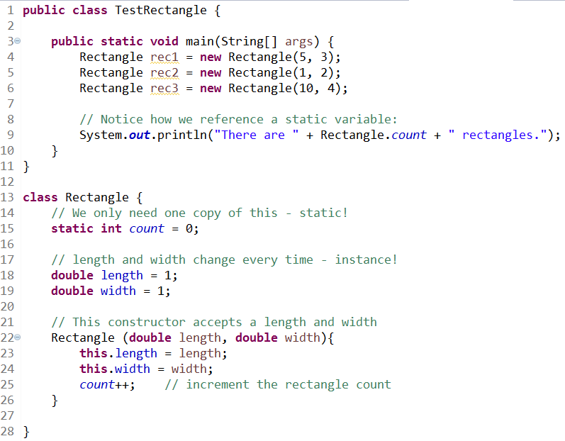

Static Variables
Static variables are declared and referenced in a different way.

Slide 23
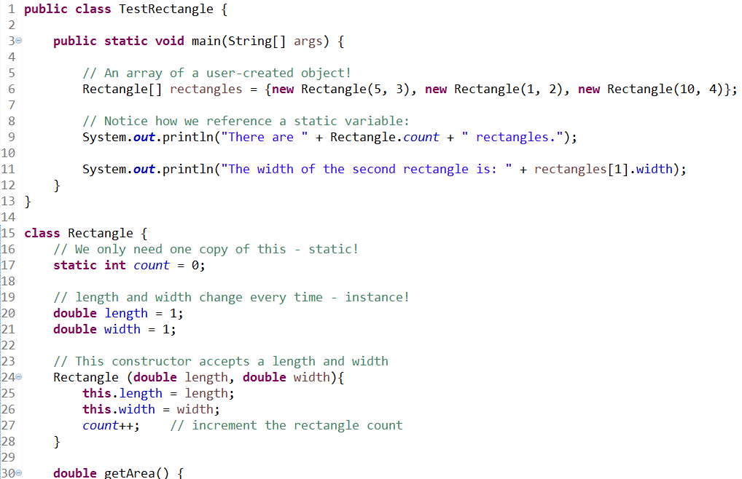
Arrays of Objects
We can also create arrays of our objects!

Slide 24
Public vs Private
Like Python, we can define methods and variables to be private, which means they are only accessible inside of their own class.
We use the public modifier to indicate that other classes should be able to access something.
Our default assumptions are:
all data fields will be declared private
all constructors and methods will be declared public.

Slide 25
Packages
Java allows you to group classes into packages using the package statement.
If no public/private modifier is used, then our data or methods are only accessible by other classes in the same package – aka package-private.
We’ve been working in the default package, but we may not want to do that on real projects.

Slide 26
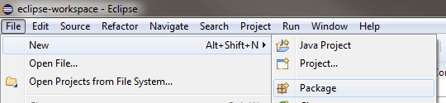
Packages
Here’s how to create a new Package in Eclipse:

Slide 27
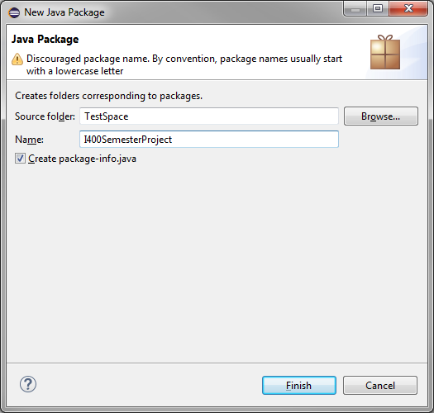
Packages
If you want, you can tell Eclipse to create a package-info.java file.
https://www.intertech.com/Blog/whats-package-info-java-for/

Slide 28
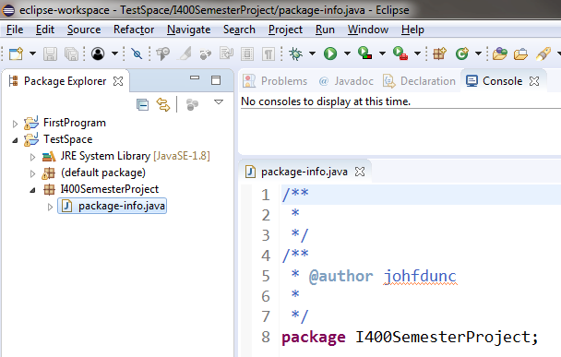
Packages
Much more information can be found here: http://docs.oracle.com/javase/tutorial/java/package/index.html

Slide 29
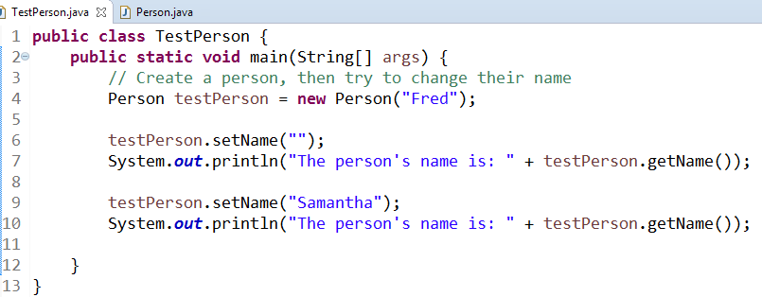
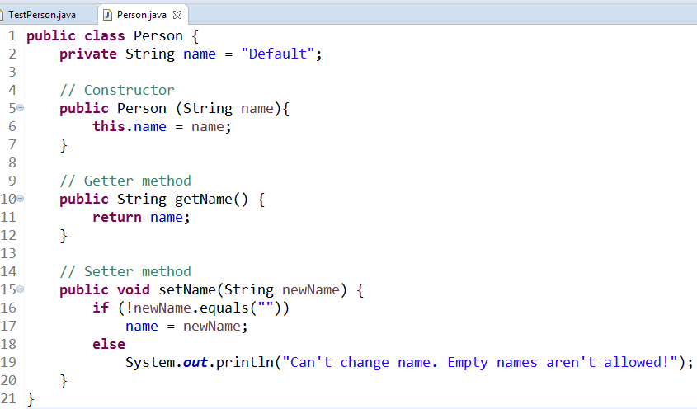

Encapsulation
We define name as private, and encapsulate it with methods.

Slide 30
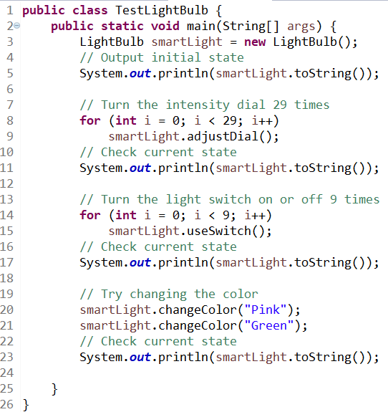
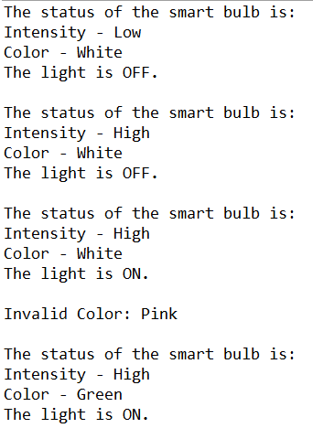
Smart Bulb (Group Work)
We’re developing the software for a smart light bulb with variable intensity dial (Low/Medium/High) and multiple color settings (Red/Green/Blue/White). We receive the following test code and desired output. Write the LightBulb class. (Test code can be downloaded from Canvas!!)

Slide 31
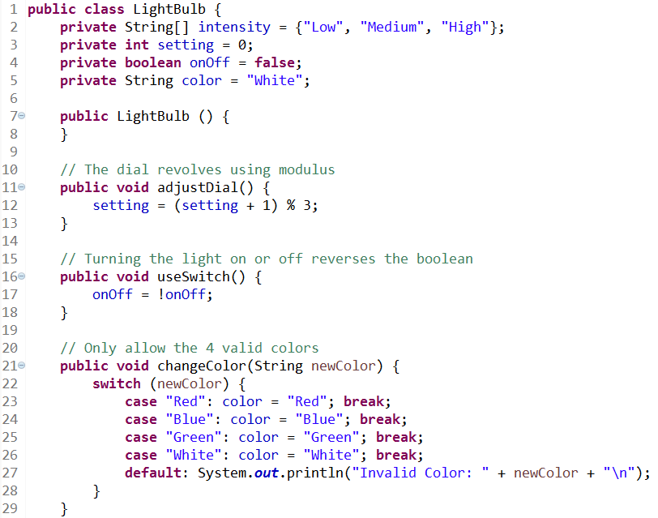
Smart Bulb (Solution pt 1)

Slide 32
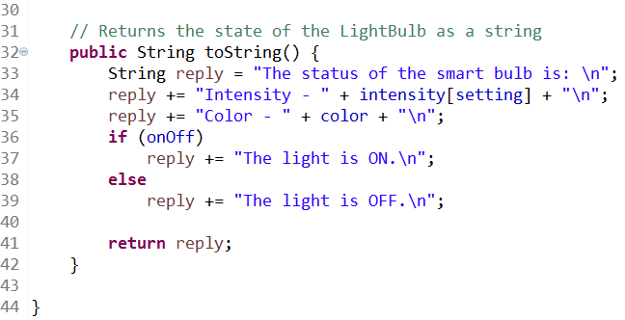
Smart Bulb (Solution pt 2)

Slide 33
Questions?

